Slide 1


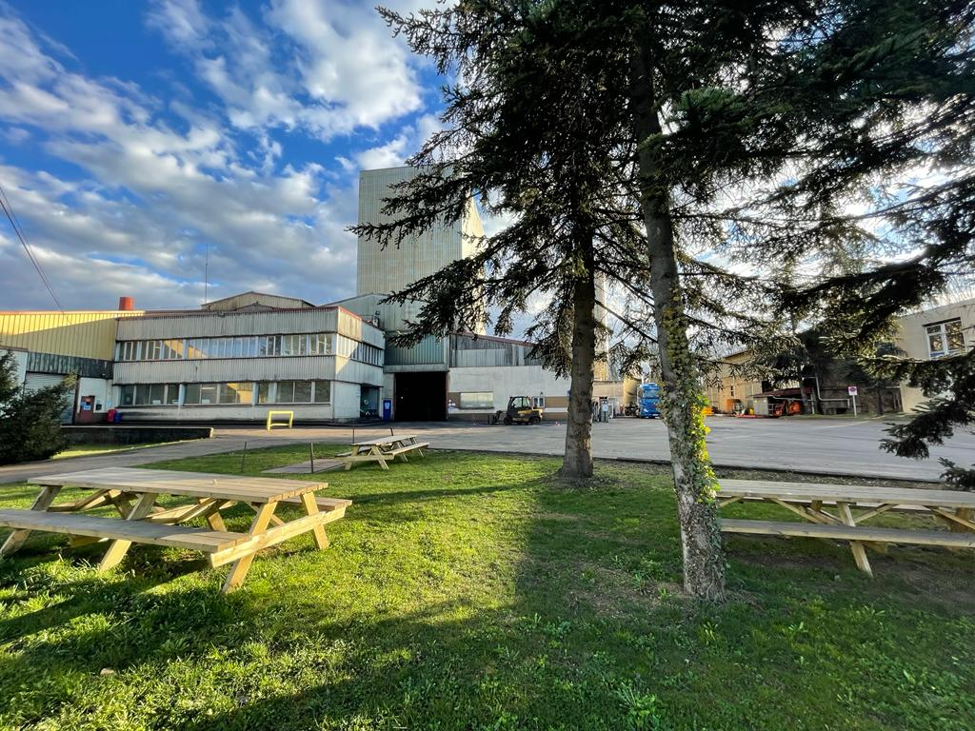
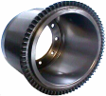
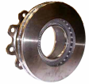

Slide 2
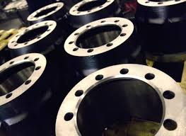
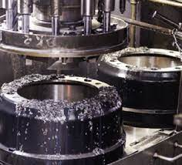
AGENDA
GENERAL PRESENTATION
PRODUCTION MEANS
OPEN Q/A

Slide 3
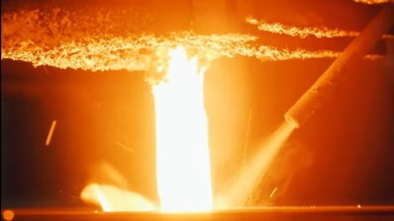
GENERAL PRESENTATION
Your partner for high quality brake drums, discs & flywheels parts in grey iron.

Slide 4

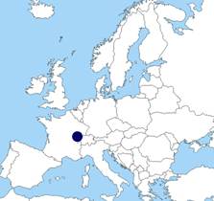

270 Employees
90% for exportation
50% exported in Germany
OEM European leader Truck/Trailer Drums
    65% of the Market share (Truck)
OEM significant player Trailer Discs
Fiday Gestion is located in the north-east of France

Slide 5
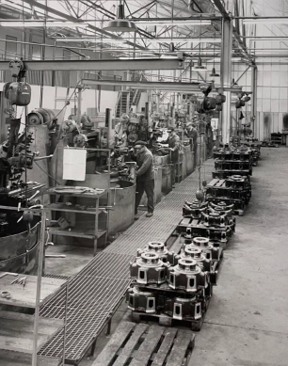

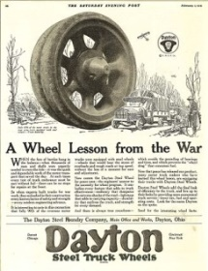
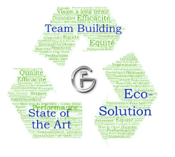
1914 : Manufacture of shells and grenades
Between two wars : agricultural materials, weights, scale frames, kitchen and heating items, and enameled cast iron
1945 : large mechanical parts and machine castings in large series
1972 : The company was bought by Mr. Fisher and Mr. Dayton Walther Corp. and became FIDAY
Fiday is composed of two active units:
Foundry located at Chassey lès Scey, which manufactures raw parts.
Machining located at Luxeuil Les Bains
1984 : co-management by Lebanese shareholders and Fiday Gestion
Foundry and machining are groupped at Chassey lès Scey
Our values

Slide 6

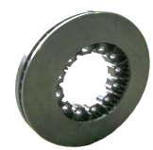
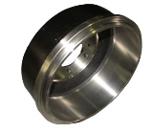
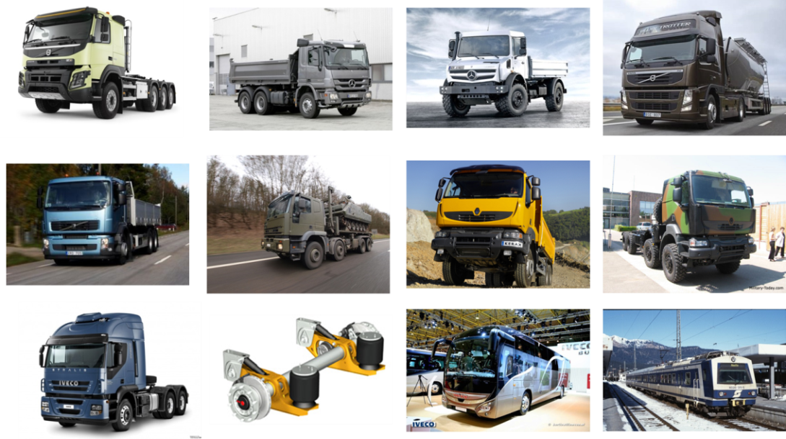
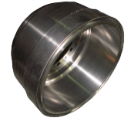
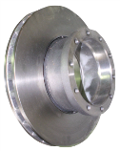
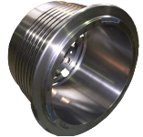
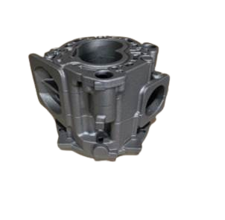
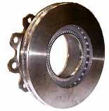
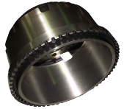
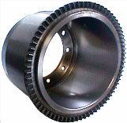
SOME PRODUCTS MADE BY

Slide 7

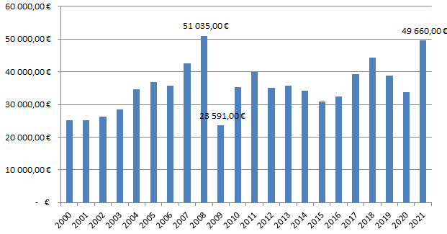
Turnover

Slide 8
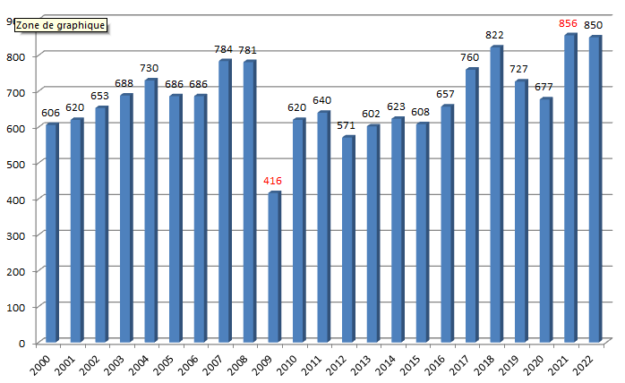
Yearly sales
2022, Forecast
2020: resilience (-6,7%) despite COVID-19
2021: in line with Compound Annual Growth Rate from last 5 years (pre-COVID) 4,4%

Slide 9
TURNOVER AND INVESTMENTS EVOLUTION
Lost Foam layout, Automatic remoulding
Used corer
Disc robotic machining line
Automatic pouring step 2
Automatic pouring step 1
Sand recycling prototype,
Lost Foam molding line,
Warehouse extension
Cupola heat exchanger
Molding filter,
New cupola,
Machining lathes
Anti corrosion protection line
Machining extension,
Molding line revamping
Discs machining facilities
Core shop
Cupola revamping, Spectrometer
Machining capacity increasing
New sand shop
New molding line
New cupola holding furnace
Approximately 5% of turnover is dedicated to investments

Slide 10
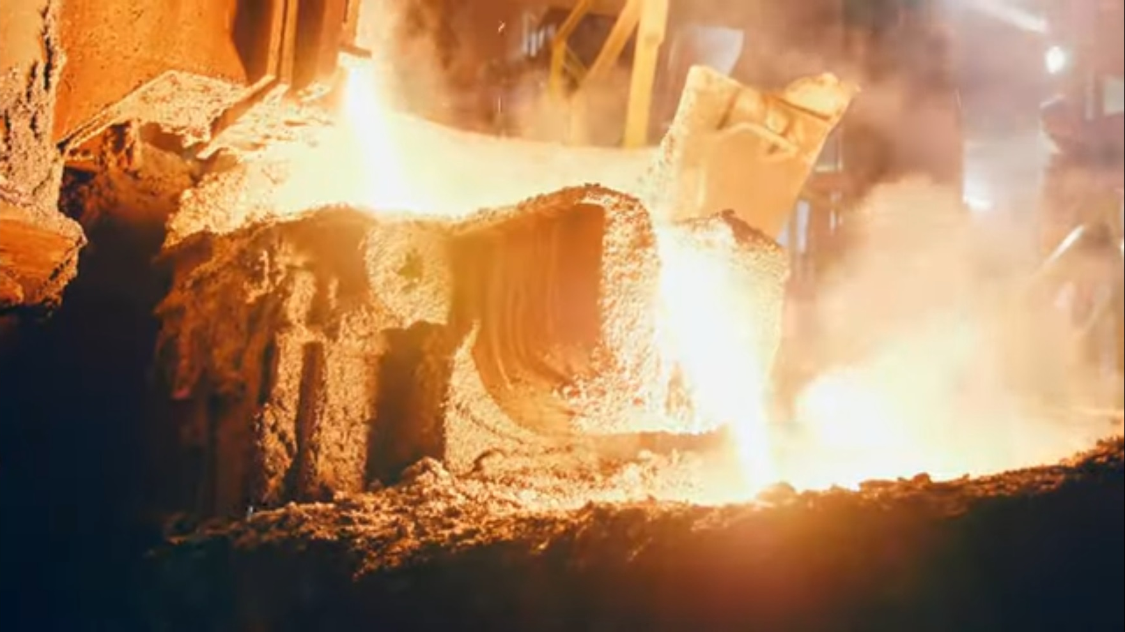
2 . PRODUCTION
MEANS

Slide 11
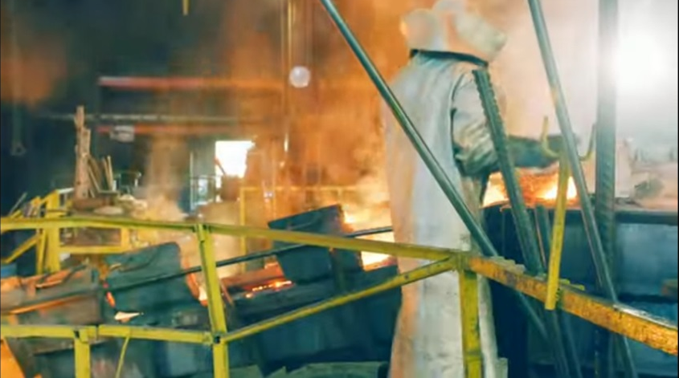
Fiday key figures
Foundry dedicated to Grey Iron
All integrated production : casting lines (Green Sand & Lost Foam), Machining, Warehouse
Specialist in brake discs, brake drums (N°1 in Europe), and flywheels
Parts for all heavy vehicles (trucks, trailers, buses, trains, …)
Maximum grey iron production capacity of 28 t/h (with a hot wind cupola)
Automatic casting
Green sand casting : 900 000 p/year or 60 000 tons/year
Lost Foam casting : 15 000 tons/year
Machining capacity : 1 000 000 p/year

Slide 12
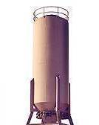
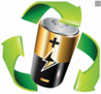
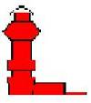



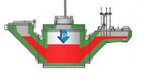



GREEN SAND CASTING PROCESS
Raw Materials
Coke, Steel Scraps, Iron alloys
Hoppers
Sand, Clay, Coal Dust, Water
32%
of new materials
TROLLEYS
68% of
recycling
materials
SAND MIXING
CORE SHOTING
Hot wind cupola
20% of our
production with brake discs
MOULDING
230 moulds/hour
Holding furnace
Sand 97% recycled
Pouring
Turning, gating system and
internal scraps 100% recycled
COOLING LINE
SHAKING OUT
Internal and external machining, drilling, taping.
PAINTING
FETTLING
(shot blasting, grinding, …)
WAREHOUSE AND SHIPMENT
PACKAGING
MACHINING
22% of by products recycled 11% of wastes
67% of iron sold to our customers which can be 100% recyclable

Slide 13
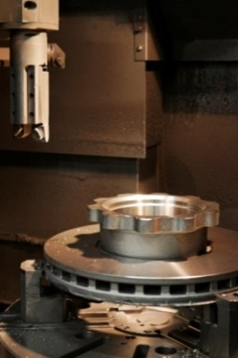
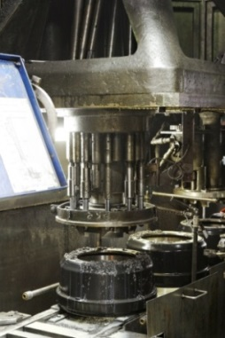
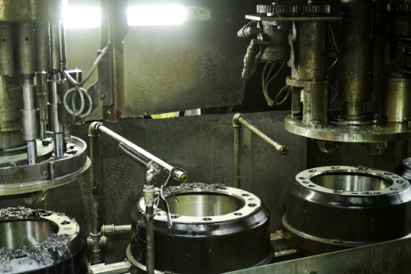
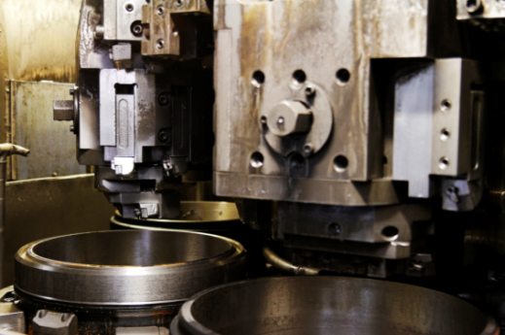
MACHINING
7 machining centers / 6 vertical multi spindles lathes / 18 vertical CNC lathes
4 horizontal CNC lathes / 9 multi spindles drilling machines

Slide 14
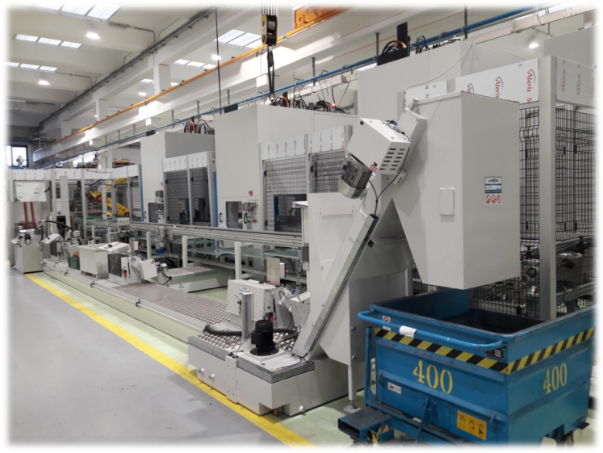
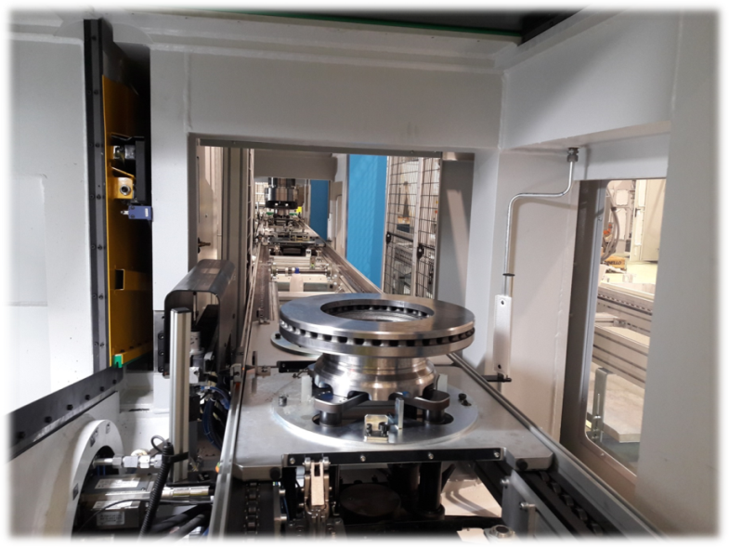
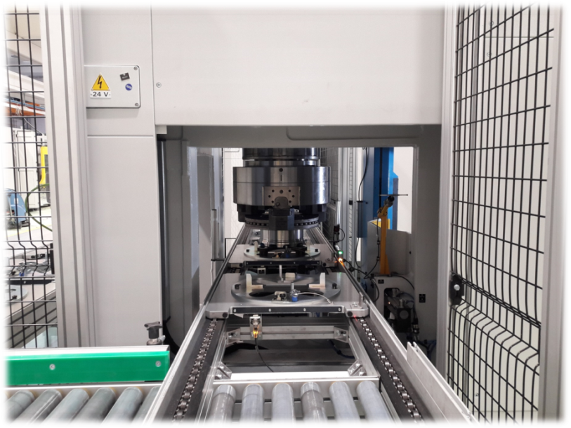
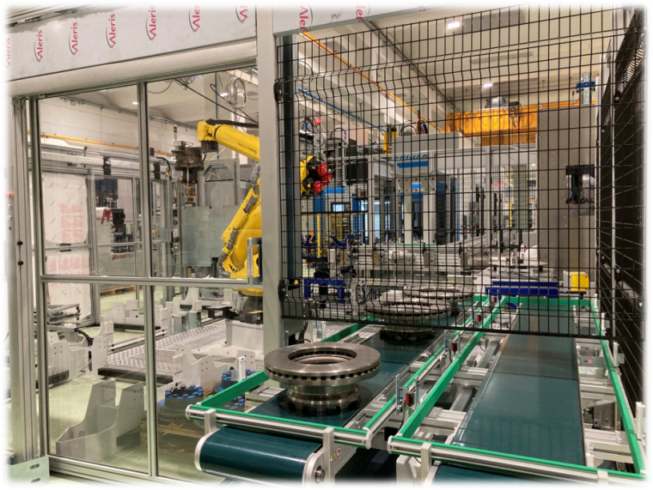
DISC ROBOTIC MACHINING LINE (2021)

Slide 15
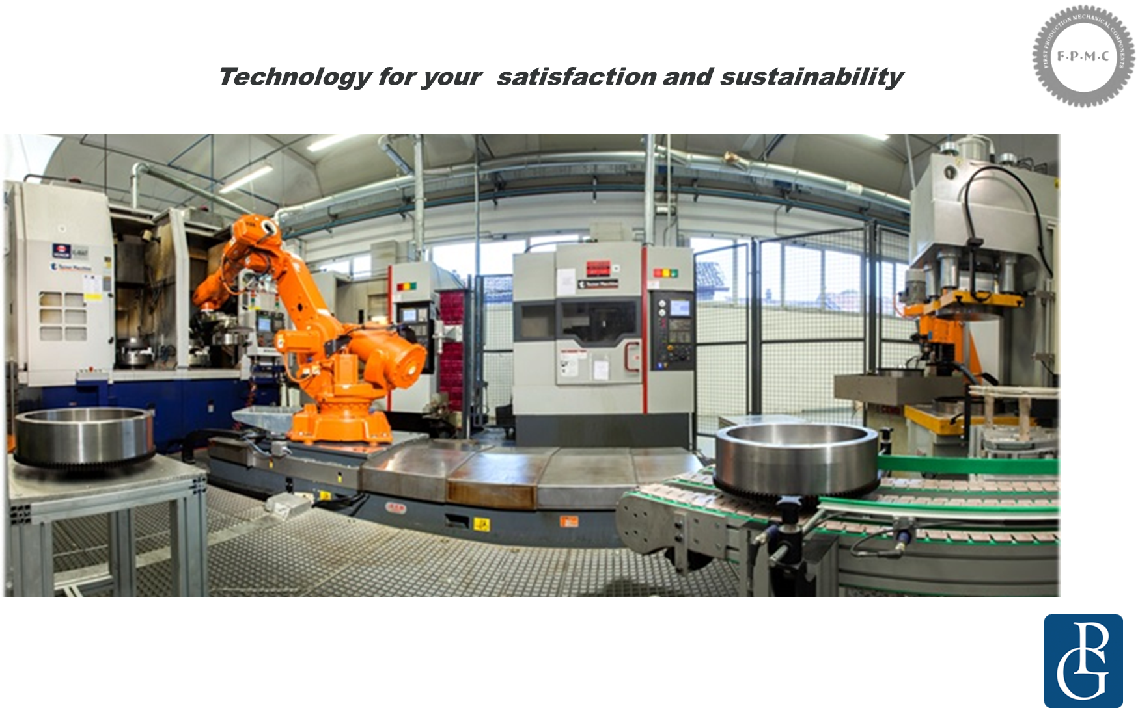
FLYWHEELS MACHINING

Slide 16
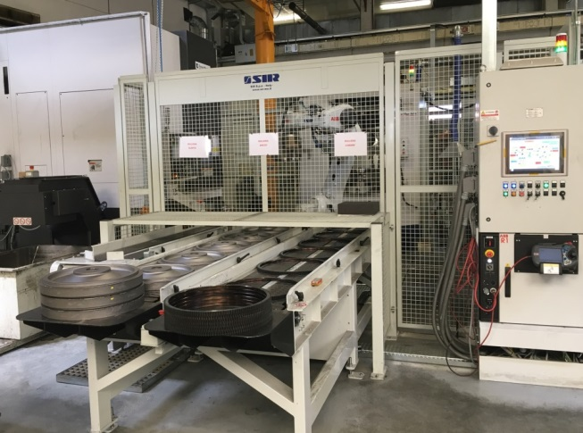
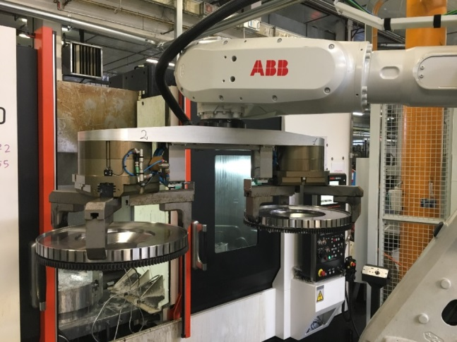
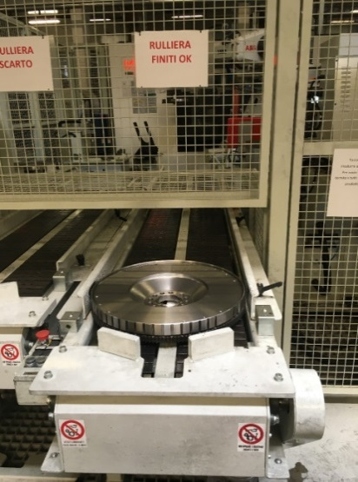
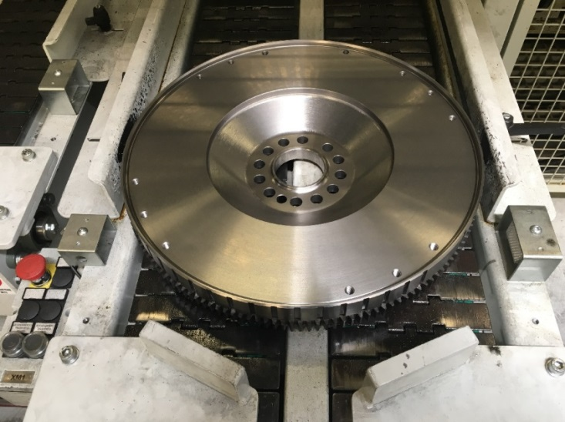
FLYWHEELS MACHINING
Raw part arrived from
Fiday Gestion
Part machined in Italy

Slide 17
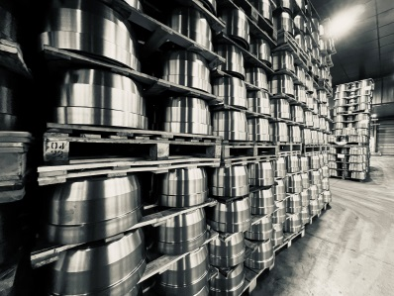
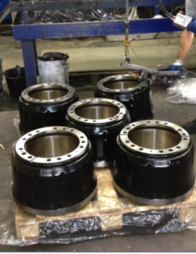
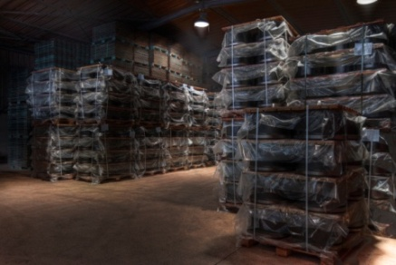
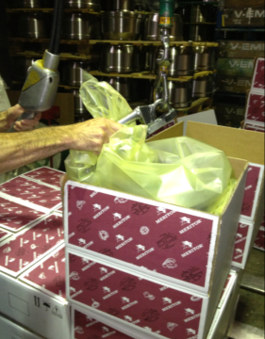
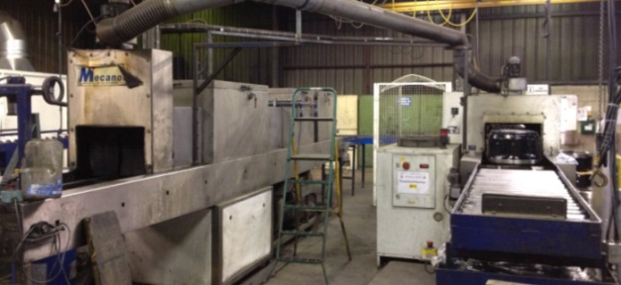
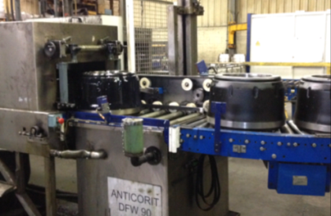
WAREHOUSE AND SHIPMENTS
Possibility of standard or special packaging at the request of customers for all types of transports (road, sea, …).
Our storage capacity is up to 9000 m² or 140 000 pieces.
We have a treatment process to protect our parts against corrosion.

Slide 18
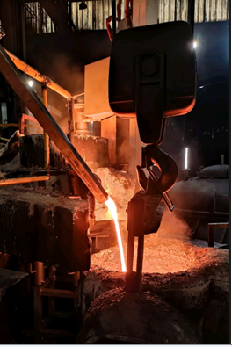
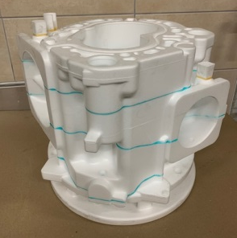
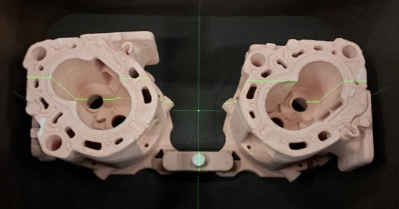



LOST FOAM CASTING
Technology benefits
  Ideal for complex parts or brake discs.
  Small and Large pieces (1 kg to 300 kg).
  Useful dimensions : 1000 x 700 x 650 mm
  Weight gain, reduced machining and fettling time.
  Reduced and optimized production costs by assembling many parts per mold.
Process :
2
Coating
5
Pouring
1
Foam pattern
3
Clustering
4
Compacting
6
Casting

Slide 19


GREEN SAND CASTING
Unique foundry system in Europe by casting from the center of the part, upside down.
This solution allows to be sure :
  That quality is optimal where mechanical characteristics are needed.
  That potential structure defects are not in functional areas.
Casting has become automatic since January 2017
  youtube video link:
  https://youtu.be/iJsKWz89QqE
Potentiel Stucture defects here
Potentiel structure defects here
Optimal characteristics there
Optimal characteristics there

Slide 20





GREEN SAND CASTING
Use of square boxes for symmetry, ensuring homogeneous behavior
  750 x 750 x (2x320) mm
  “Autobalacing”
Codesign
  Chemical analysis optimization (alloy content)
  Dimensional optimization
  2 per mould
Miscellaneous
  ABS teeth from Green sand or Core
  Testing devices
  Ligther Rotors development
  Computerized process

Slide 21

Q/A ?
Q/A?

